Slide 1
The decarbonization promise of community-scale battery storage
how battery storage will help NYC achieve its decarbonization goals

Slide 2
NineDot builds urban, community- scale clean energy projects
We have the largest active portfolio of community clean-energy projects in the New York City metro area
Our primary focus has been on building battery storage in the Bronx, Brooklyn, Queens, and Staten Island, with new projects in Long Island and Westchester
We are well on our way to achieving our goal of 400 MW installed by the end of 2026
We help make the New York City metro area power grid cleaner, more resilient, more equitable and less costly
| © NineDot Energy 2023

Slide 3
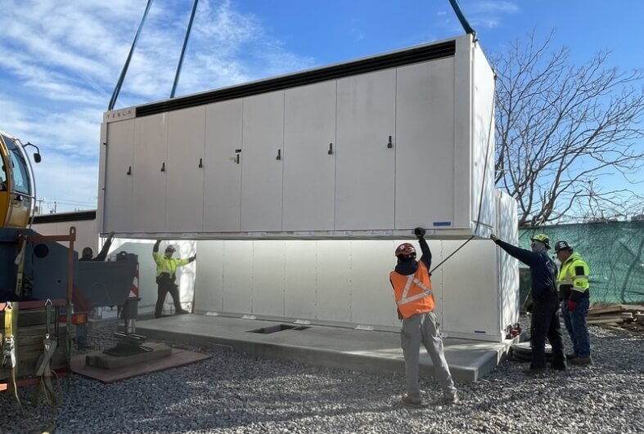
Storage can be monetized through the Value of Distributed Energy Resources (VDER)
New York State established the VDER program to compensate distributed generation
Requires utilities to compensate projects based on the value they provide to the grid (“Value Stack”), in the form of bill credits
NineDot Energy operates in accordance with VDER’s “Value Stack” compensation
Project owners subscribe customers to the batteries to claim bill credits
Distributed generation in NY is only compensated 60 days a year, for a total of 240 hours of dispatch
| © NineDot Energy 2023
Notes:
established by PSC
customers subscribe to the batteries to claim bill credits
NineDot operates their batteries in accordance with VDER’s value stack
VDER places almost all value on 60 days a year, mostly in the afternoons, for a total of 240 hours of dispatch

Slide 4
Starting in 2024, Local Law 97 will set limits on the allowable greenhouse gas emissions of covered buildings to help New York City reach the goal of a 40% reduction in greenhouse gas emissions from buildings by the year 2030, and 80% reduction in citywide emissions by 2050
| © NineDot Energy 2023

Slide 5
Local Law 97 and the role of battery storage
In 2025, an owner of a covered building who submits an annual emissions report which indicates the building exceeded its annual emissions limit will be liable for a $268/tCO2e fine above their building’s limit
Building owners that use an energy storage system can report emissions based on the hourly consumption as calculated by a Time-Of-Use (TOU) coefficient
TOU coefficient, created by DOB, captures the emissions intensity of grid electricity of each hour of the year
| © NineDot Energy 2023

Slide 6
The TOU methodology is complex
TOU_{n}= (HM_{n} – RAM_{n}) + g_{ue}
| © NineDot Energy 2023
NYC Dept of Buildings

Slide 7
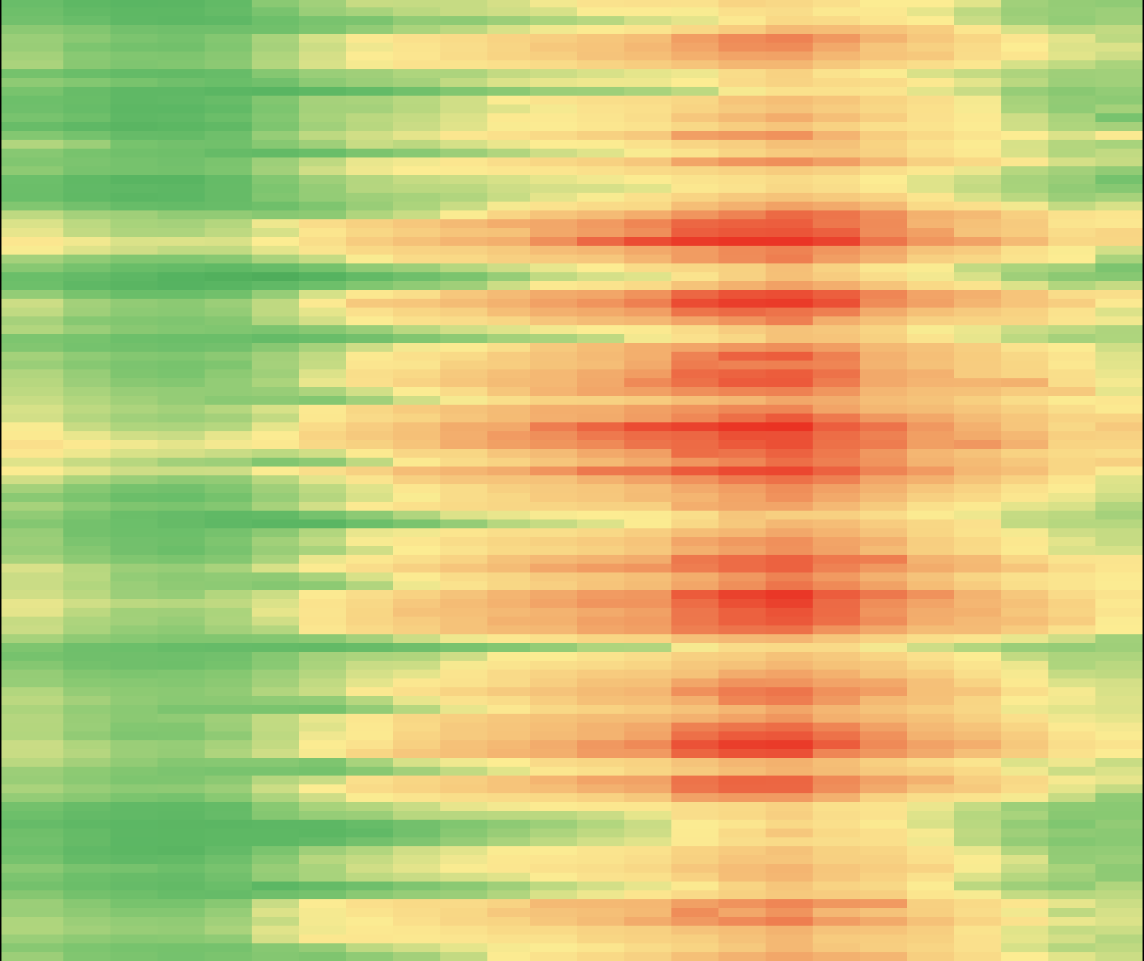
NYC TOU emissions
(avg 2021-2022)
0:00
8:00
16:00
20:00
June 1
a 5MW battery operating according to the 240 hours of the VDER calendar would offset ~370 tons CO₂
370 tons CO₂ offset represents $99,000 in reduced fines
1,017 kg of CO₂ per MWh
8 kg of CO₂ per MWh
| © NineDot Energy 2023
Sept 15

Slide 8
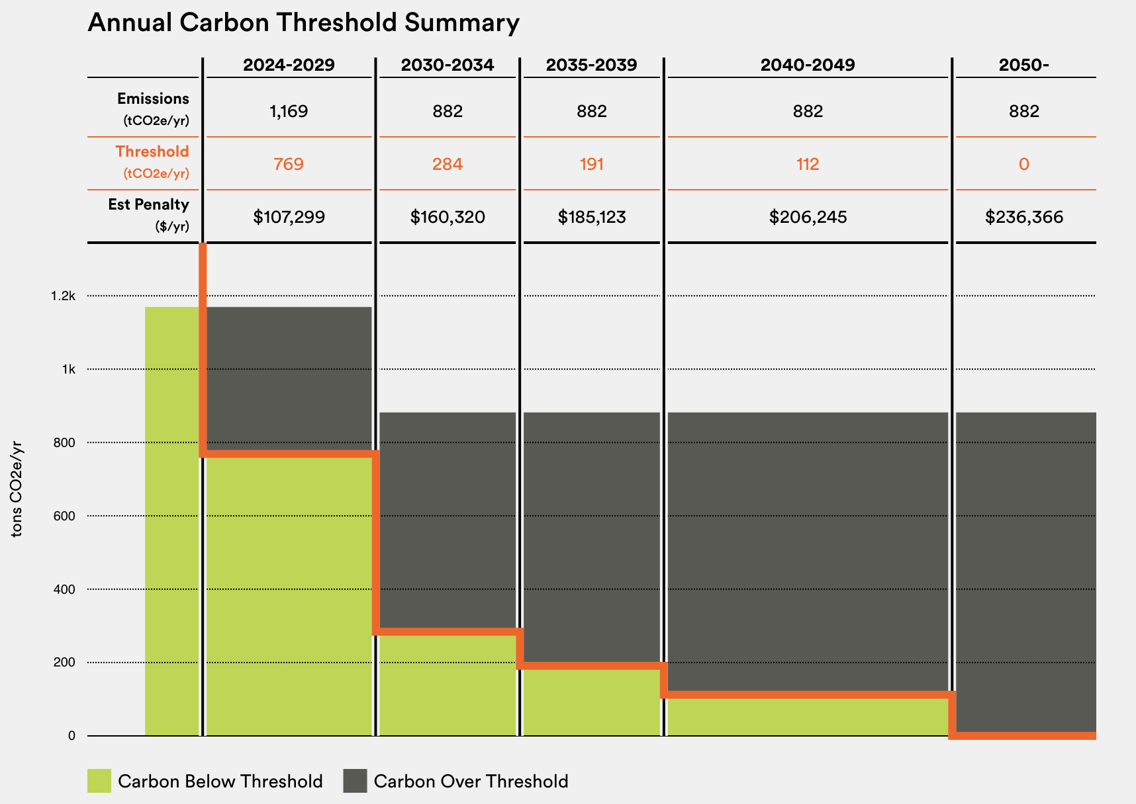
LL97 example
799
78,000 sq ft fitness center
400 tCO₂/year over their allowable emissions facing $107,299 annual fines
subscribing to a 5 MW BESS can claim 370 tCO₂ reduction on their annual report
reduce fines by $99,000
$8,293
5 MW ESS
370 tCO₂e reduction
| © NineDot Energy 2023
Building Energy Exchange
be-exchange – ll97-calculator

Slide 9
ESS host and subscriber benefits
NYC Property Energy Storage Benefit |  | Host Site | Subscriber Sites
 | If subscribed, reduce annual emissions based on ESS TOU accounting from battery activity | Yes | Yes
 | Subscribe to VDER credits to for on-bill reductions | Yes | Yes
 | Claim a deduction on annual emissions report based on battery size installed on site | Yes | No
 | Earn site lease revenues and claim tax deduction | Yes | No
 | Enable electric vehicle charging capacity and amenities on site | Yes | No
 | Option to purchase backup power capabilities | Yes | No
Local Law 97 acknowledges the benefits of energy storage systems : buildings who use both on-site and off-site systems can claim GHG reduction benefits
| © NineDot Energy 2023
Notes:
Ideal sites will…
Be within a ConEd network that is especially constrained
Have substantial electrical infrastructure on/nearby that can support the BESS
If EV charging is desired → be proximate to on-site parking facility
If backup power if desired → be within 1,000ft of common/critical loads

Slide 10
The growing opportunity for battery storage
Jan 1
NYC’s grid peaks in the winter months
According to NYC’s emissions methodology, BESS have a significant emissions reduction opportunity for the summer and year round
Emissions patterns will continue to shift with further electrification and new generation sources
1,877 kg of CO₂ per MWh
8 kg of CO₂ per MWh
| © NineDot Energy 2023
Dec 31

Slide 11
Thank You
Contact Us
E: maddie@nine.energy
370 Jay St Fl 7, Brooklyn, New York, 11201, US
| © NineDot Energy 2023

